Slide 1

ACME Inc
Sales Report
Monthly Sales Recap - September 2024

Slide 2

Agenda
What this report will cover
Wins and Highlights
Summary of Sales Activities
Summary of Sales KPIs
Sales Forecasts
New Sales Goals
Announcements and Reminders

Slide 3



Major Wins
We gained five
new clients.
Three of these clients
are from cold calls.
Key client ARR Industries doubled its order.

Slide 4
Summary of
Sales Activities
What we're working on

Slide 5

Sales Teams
Team DXD is currently implementing the 2025 digital sales campaign.

Slide 6
Selling Activities
01
02
03
04
05
Generating leads
Qualifying leads
Getting in touch with leads
Meeting
with leads
Closing
sales deals
Pre-record your presentation to present anytime, anywhere.
Add audio or record yourself talking over a presentation.
It’s excellent for capturing audiences beyond a
one-time event.
Engage with your audience using
Live Q&A.
Send surveys and questions your audience can answer on their devices.

Slide 7
Sales Leads
2,111
Total number of leads created YTD

Slide 8
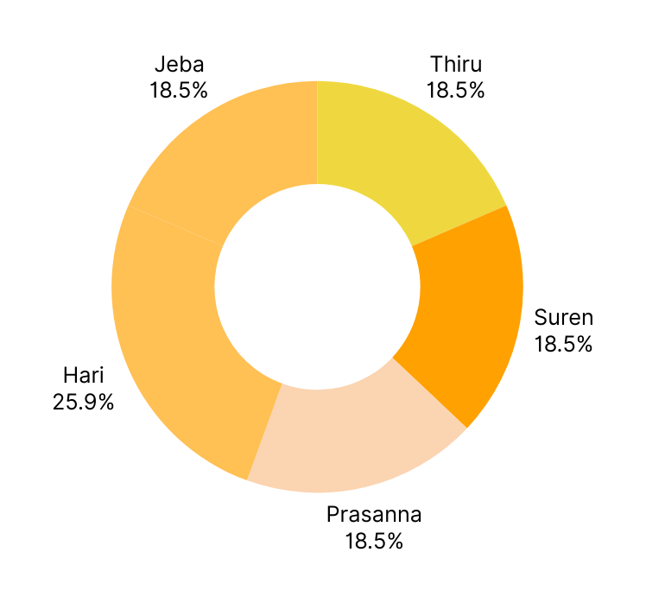
Sales
Leads
By Sales and Event Coordinator
HARI HAD THE HIGHEST PERCENTAGE OF LEADS IN JANUARY AT 25.9%.

Slide 9

Summary of
Sales KPIs
Whether we met our targets

Slide 10

New Customers
211,119,810
Newly acquired customers YTD
Goal: 300,000,000

Slide 11
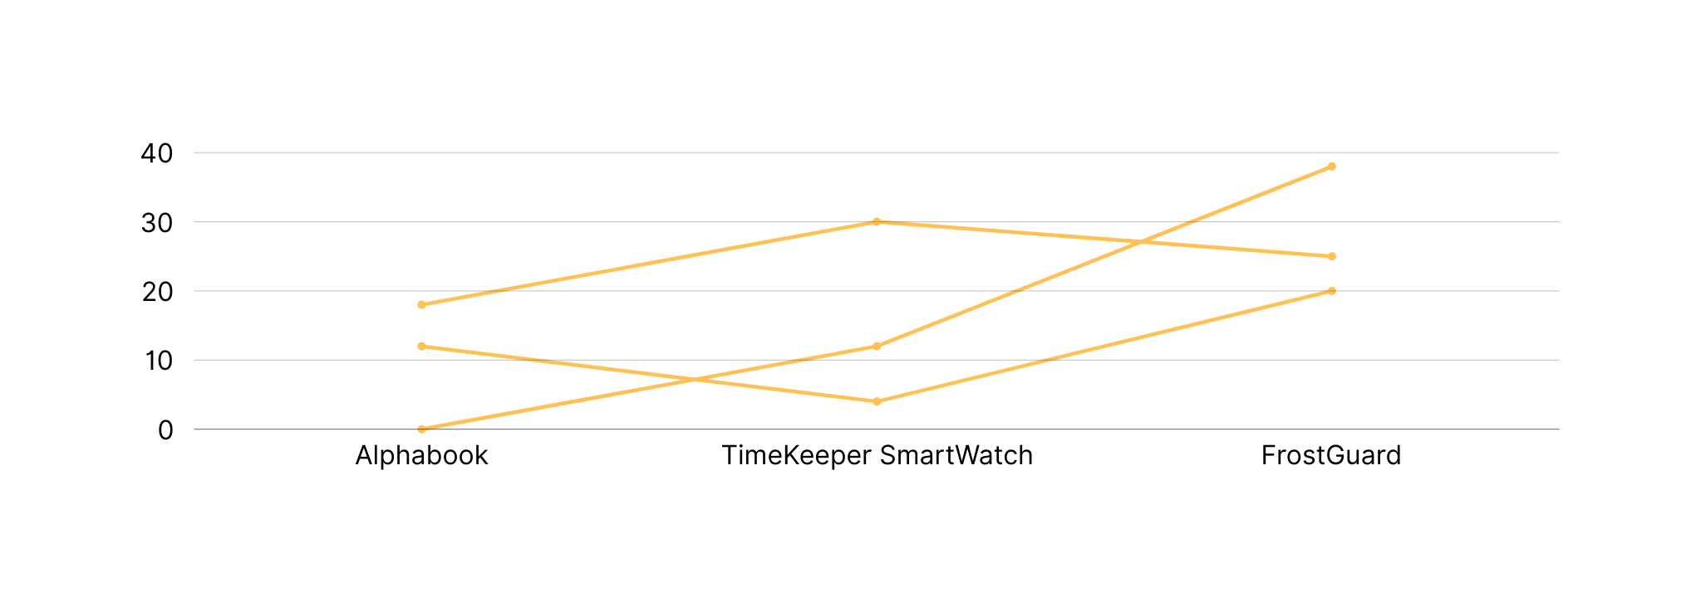
Revenue
COMPARED TO THE PREVIOUS YEAR, 2030 SAW A 15% INCREASE IN REVENUE.
Current month sales

Slide 12
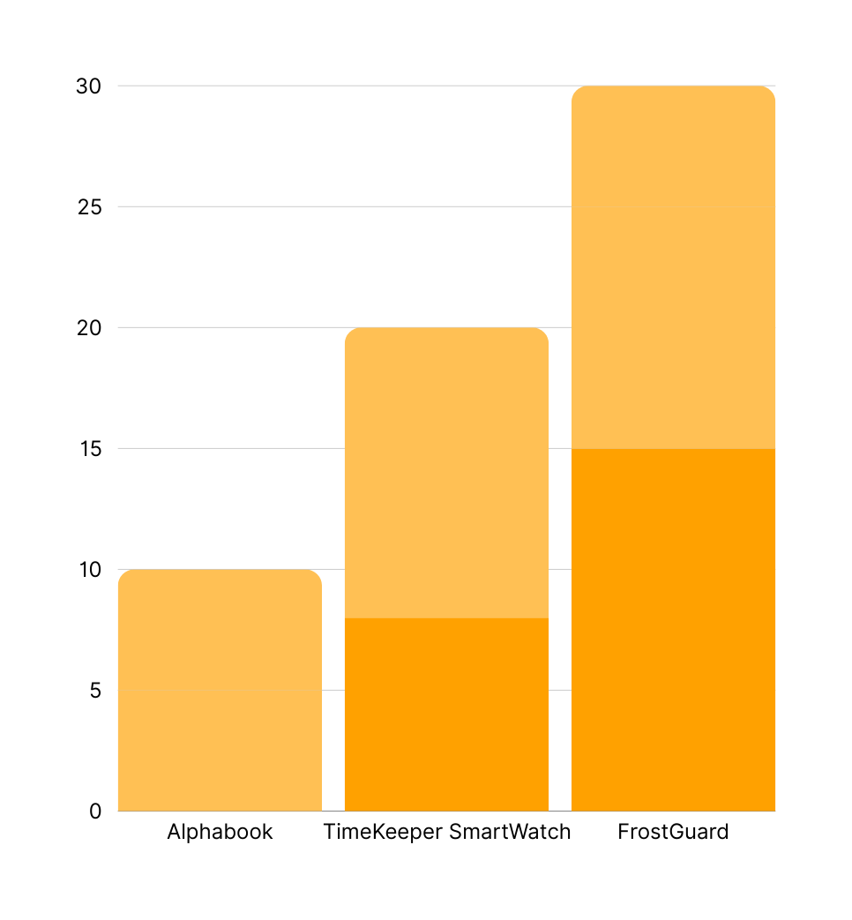
Profit
Monthly sales growth
OUR MONTHLY SALES HAS BEEN STEADILY INCREASING IN THE PAST FIVE MONTHS.

Slide 13
Sales Forecasts
Where we are headed

Slide 14
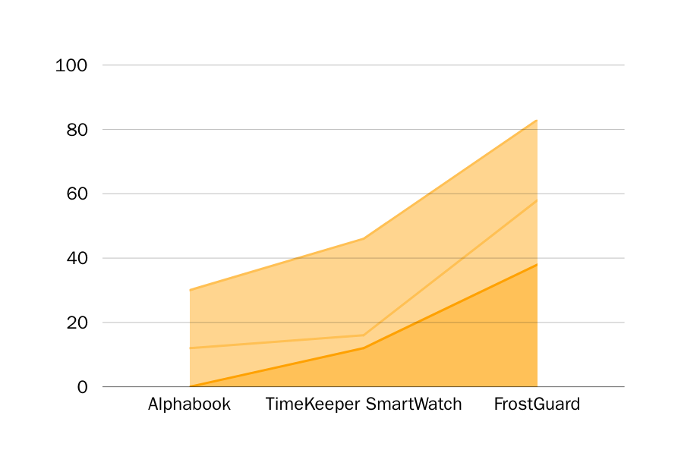
Projected Growth
WE EXPECT GROWTH AT A RATE OF AT LEAST 25% IN THE NEXT FIVE MONTHS.
Monthly sales projection

Slide 15
Sales Forecasts
210
$211,181
Forecasted deals next month
Forecasted revenue next month
Present with ease and wow any audience with Canva Presentations. Choose from over a thousand templates to fit any objective or topic.
Present with ease and wow any audience with Canva Presentations. Choose from over a thousand templates to fit any objective or topic.

Slide 16
Sales Timeline
Phase 1 of 2030 Digital Sales Campaign
 |  | MONTH 1 | MONTH 2 | MONTH 3 | MONTH 4
PLANNING
RESEARCH
PROTOTYPE PRODUCTION
TESTING
QUALITY ASSURANCE
FOLLOW UP
PROTOTYPE PRODUCTION
DOCUMENTATION

Slide 17




New Sales Goals
Make $2,111,198 in sales by the end of the calendar year
Make $111,198 in sales
by the end of Q1
Meet with 30 prospective clients by February
Make 2,134 cold calls
by the end of Q3
Make $800,000 as a team by the end of the calendar year

Slide 18
Next Steps and Action Items
01
Target
large enterprises.
02
Retrain low-performing coordinators.
03
Implement the new CRM system.
04
Assign high performers to new territories.
05
Present 2030 targets at
annual staff meeting.
What we'll work on next month

Slide 19
The Sales Team
Helping the company surpass its sales goals
Prabagar
President
Senthil
Chief Finance Officer
Vignesh
Director
Vinish
Accountant
Vaishnavi
Finance Manager

Slide 20
Thank you!
Feel free to approach us if you have any questions.

